Slide 1
STEEL PRODUCTION DATA ANALYSIS
Prepared by - Deepna Pradeep Venghilot
Matrikel Nr - 12455458

Slide 2
Abstract
This project focuses on evaluating steel production data to build regression models to predict the factors which determine the steel quality.
The main objective of this project is to reduce the defect occurrence, improve product quality and to increase the overall performance .
The process workflow includes data preprocessing, exploratory data analysis(EDA), model building, training, evaluation and visualisation.

Slide 3
Introduction
PROJECT OVERVIEW
Steel production consists of different stages where factors like temperature, chemical composition, processing time, impurities, pressure and cooling rate depends the quality of steel.
This study helps manufacturers to identify the quality results and increase overall process efficiency.

Slide 4
OBJECTIVES
The main objective is to predict a factor that describes the steel quality before the production process with the help of regression models.
To lower defect occurrence to enhance quality for higher productivity.
To analyse model performance using evaluation metrics.
To visualize results and derive meaningful insights.

Slide 5
Data Description
DATASET CHARACTERISTICS
The project has two datasets – the training dataset and the testing dataset.
Both the datasets consists of 22 columns including the target variable(output).
The train dataset has 7642 entries while the test dataset has 3337 entries.

Slide 6
PREPROCESSING STEPS
Removal of duplicate records.
Handling missing values using mean/median imputation.
Outlier detection and treatment using IQR method.
Conversion of categorical variables into numeric values.
Checking data consistency.
Data Normalization and data splitting into training, testing and validation splits.

Slide 7
Methodology
MODELS IMPLEMENTED
The following regression models were implemented and evaluated.
Random Forest Regressor
Support Vector Machine(SVM)
Multi-Layer Perceptron(MLP)
Gaussian Process Regressor

Slide 8
TRAINING APPROACH
The dataset is split into training, testing and validation split.
The models are trained using the training data.
Each model identifies the relationship between the parameters and steel quality using its corresponding learning algorithm.
Model predictions are based on the test dataset.

Slide 9
Results
PERFORMANCE METRICS
All the above mentioned models were evaluated using the following metrics.
Root mean squared error(RMSE)
Mean absolute error(MAE)
R2 score

Slide 10
VISUALISATIONS
The below visualisations were produced
Model comparison bar chart(RMSE, MAE, R2).
Prediction vs Actual plots validate prediction accuracy.
Residual plot to analyse error distribution.

Slide 11
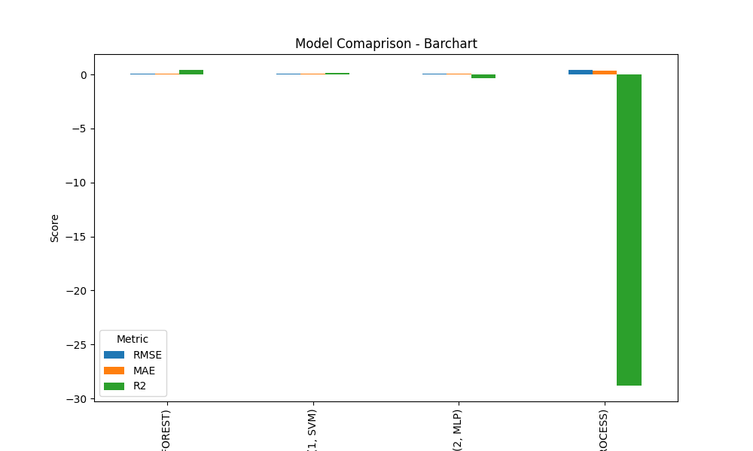

Slide 12
Discussion
MODEL COMPARISON AND INSIGHTS
Among all the models, Random forest model performed well followed by SVM.
Random forest model has the highest r2-score of 0.39 with least error values (0.06 - RMSE and 0.04 - MAE).
The r2- score of SVM is 0.16 with RMSE and MSE values – 0.07 and 0.05.
The other two models underperformed with high error values and r2 score.

Slide 13
Conclusion
This project shows successful prediction of factor that describes the quality of steel at the initial production stage to minimize defect and increase overall performance efficiency.
Random Forest Regressor model showed the best performance with highest r2 score and lowest error values.
Through effective model building and training, the machine learning model helped in prediction of a factor that influence steel quality.

Slide 14
THANK YOU!!

